Slide 1
Survival Analysis On Titanic
- Manav Bhagat, Shreehar Joshi, Aashish Poudel, and Russell Kennedy

Slide 2
Outline
Introduction
Data Preprocessing
Feature Engineering & Data Visualization
Conclusions
References

Slide 3
Introduction
1

Slide 4
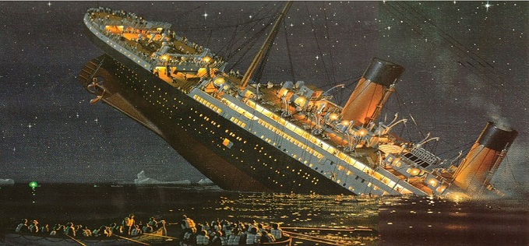
Titanic
British passenger liner
Sank on April 14-15, 1912 during its maiden voyage
En route to New York City from Southampton, England
Over 1500 passengers and ship personnel died while only 705 survived

Slide 5
Hypothesis
We hypothesize that besides luck, there were certain factors that increased survival chances of passengers in the shipwreck.

Slide 6
Data Preprocessing
2

Slide 7
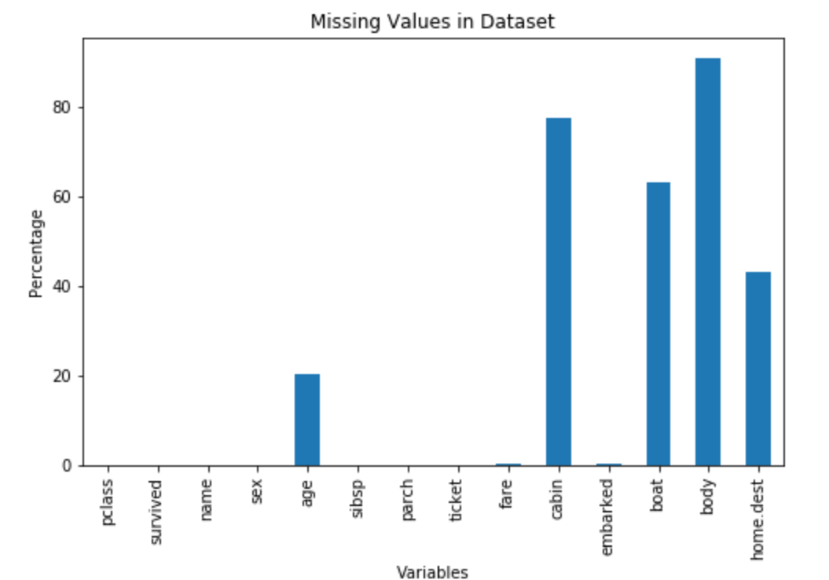
Missing Values
Variables boat, body, and cabin were removed because of large percentage of missing values (greater than 50% with some even 90 %)
Variable home.dest was dropped because of misleading and inconsistent information.
Missing values in age was replaced with median age.
Missing values in fare was replaced with mean fare.
Missing values in embarked were replaced with mode port of embarkation.

Slide 8
Feature Engineering & Data Visualization
3

Slide 9
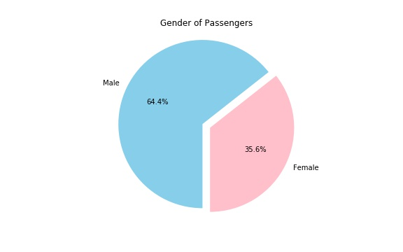
Gender Composition in Ship
Twice as many males as there were females
Potentially due to large number of young male migrants hoping for a new life in the US and Canada

Slide 10
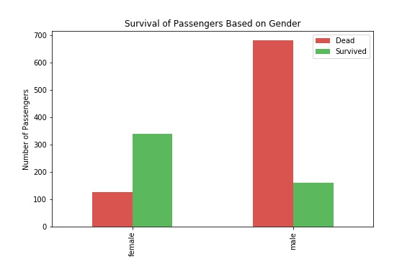
Survival Chances Between Males and Females
Large number of females survived than the males
Perhaps, females were given priority in the lifeboats
Could this also be due to differences in their age?

Slide 11
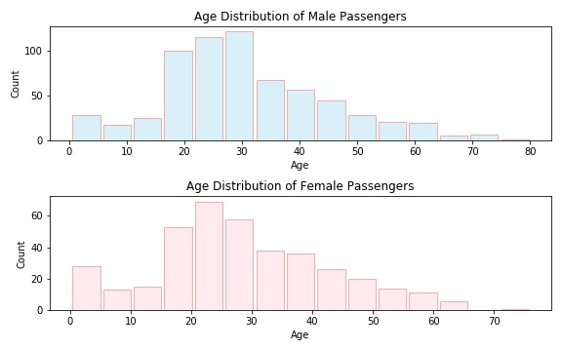
Age Distribution of Males and Females
Males and Females had similar age distribution
Both had median age of around 25
We conclude that age didn’t lead to difference in survival chances of males and females

Slide 12
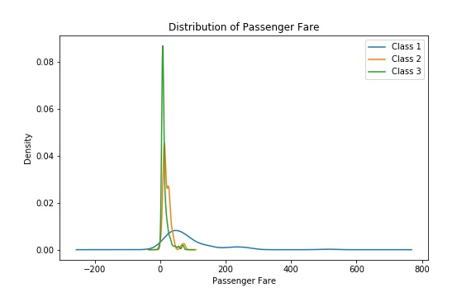
Fare Distribution between Passenger Classes
Class 2 and 3 had similar fare.
Class 2 consisted of luxury tourists and class 3 consisted of migrants
Class 1 had much higher fare than the rest
Class 1 consisted magnates, tycoons and people in power.

Slide 13
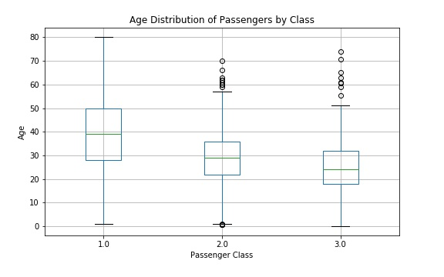
Age Distribution in Class
Median age of class 1 passengers was higher
Median age of class 3 passengers were the lowest
Differences might be due to the presence of old and experienced successful people in class 1 and young migrants in class 3

Slide 14
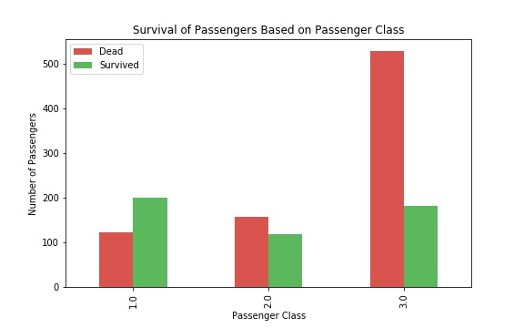
Passenger Class and Survival
Majority of passengers in class 1 survived
Majority of passengers in class 2 and 3 died
Class 1 passengers were clearly given heavy priority on the rescue stage regardless of gender

Slide 15
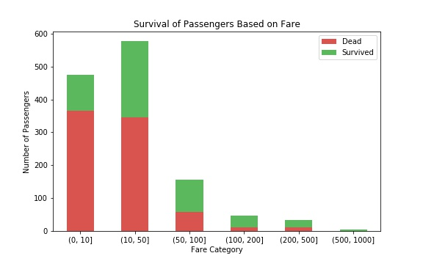
Fare and Survival
Fare Category was feature engineered from fare by using cut function
As the fare band increases, there are more number of passengers who survived than who died
Fare also played a major role in survival

Slide 16
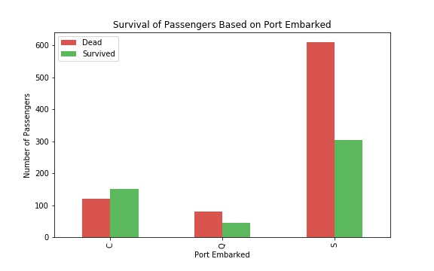
Port of Embarkation and Survival
Port C has higher number of people who survived than those who died.
Port Q and S have twice as much people who died than those who survived
This might be due to difference in passenger class and gender of the passengers
Not as much significant as variables like gender and pclass.

Slide 17
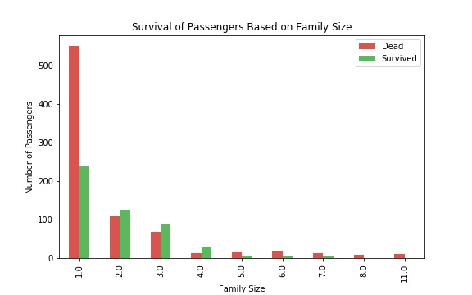
Family Size and Survival
Family was feature engineered from sibsp and parch variables
Majority of singletons died
Majority of small family ( 2, 3 and 4) members survived
Large family also had lower chances of survival

Slide 18
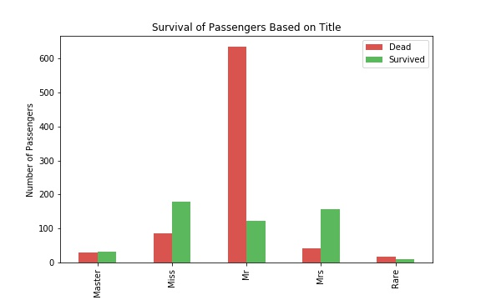
Title and Survival
Title was feature engineered from name variable
Children (Master and Miss) and Females (Mrs) were more likely to survive
Males(Mr) had the least survival chances

Slide 19
Conclusion
4

Slide 20
Groups Who Had High Survival Chances
Children
Females
Class 1 and High Fared Passengers
Small Family
Port C passengers

Slide 21
Groups Who Had Low Survival Chances
Adult Males
Class 2 and 3 Passengers
Low Fared Passengers
Singletons
Large Family Members
Port Q and S passengers

Slide 22
References
5

Slide 23
https://query.data.world/s/i3kphasugbts4cqem257cou374ijdh
https://en.wikipedia.org/wiki/Titanic
https://pandas.pydata.org/
https://matplotlib.org/
https://seaborn.pydata.org/
https://libguides.ncl.ac.uk/titanic#:~:text=On%2010%20April%201912%2C%20the,the%20ship%20began%20to%20flood.

Slide 24
THANKS!
Any questions?

Slide 25
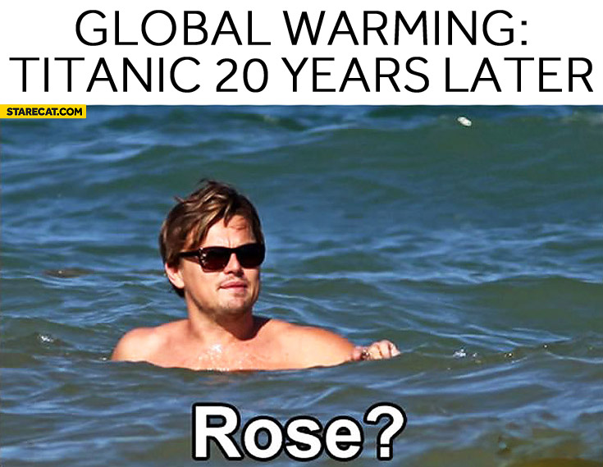
Let's End With A Smile

